Slide 1
Exam Review
What you have missed in exam 1

Slide 2
Preparation for exam
With this lesson we are going to check what we have done wrong in the exam in Jan 2017
Please take notes
Practice learning what you need to know
The exam will be different but principles will be the same

Slide 3
Step 1 Read Assignment and highlight essentials

Slide 4
Step 3 - plan your site
Draw your layout using
Pen and paper
Or Microsoft word
Home
MUSIC
dj
Merchandise
Home
DJs
DJ 1

Slide 5
Step 2 Prepare the site folders
Site > New Site
Unizip the file and use the folder for your site folder

Slide 9
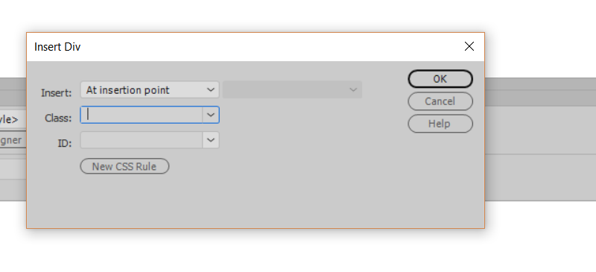
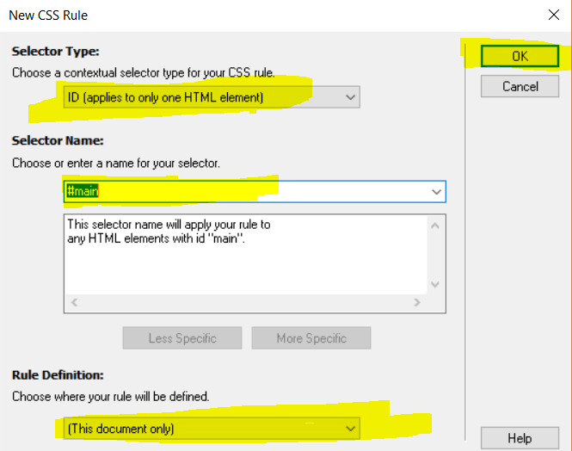

Slide 20
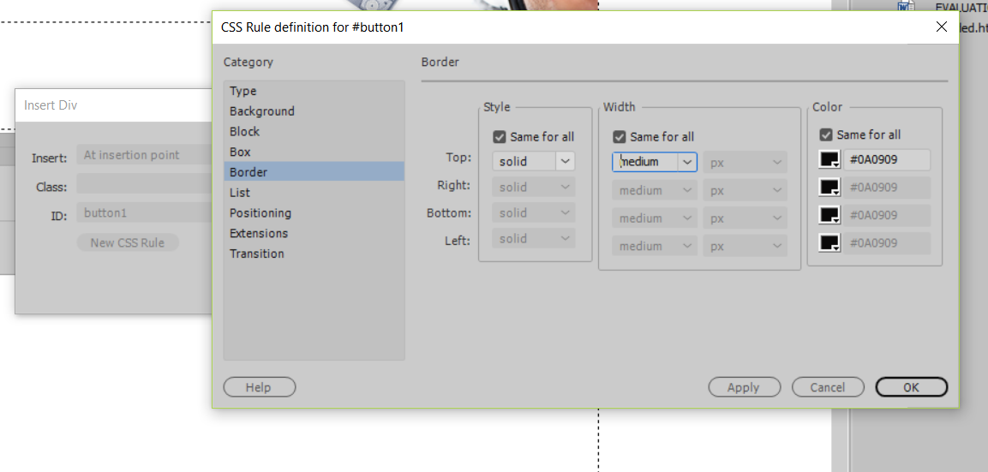
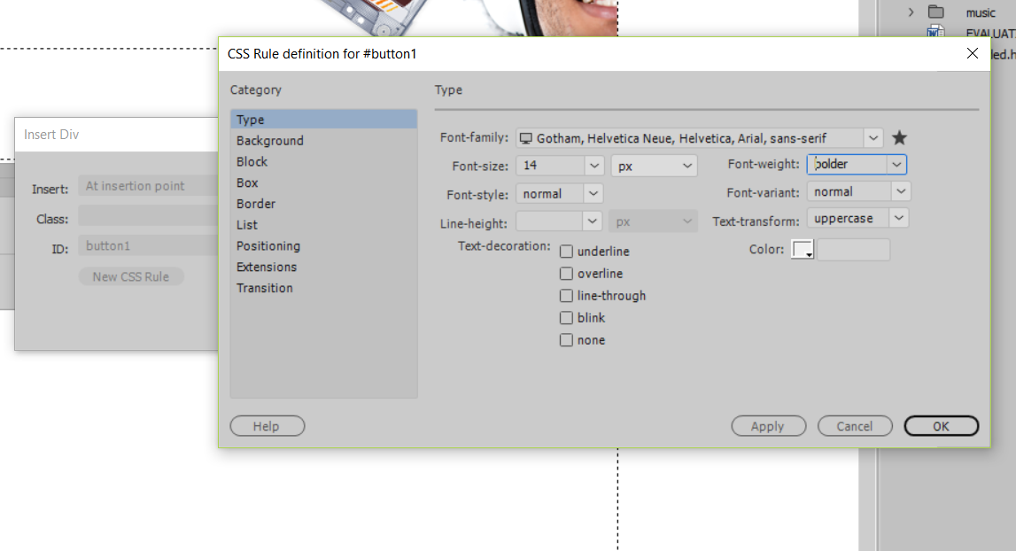
Inserting button 1

Slide 22
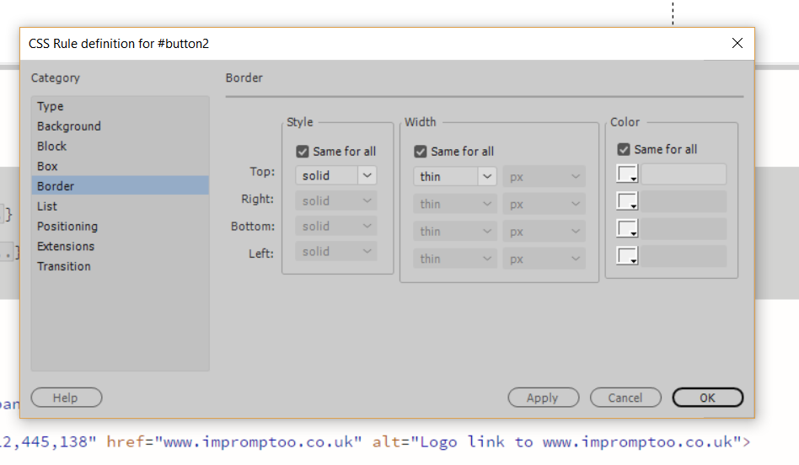
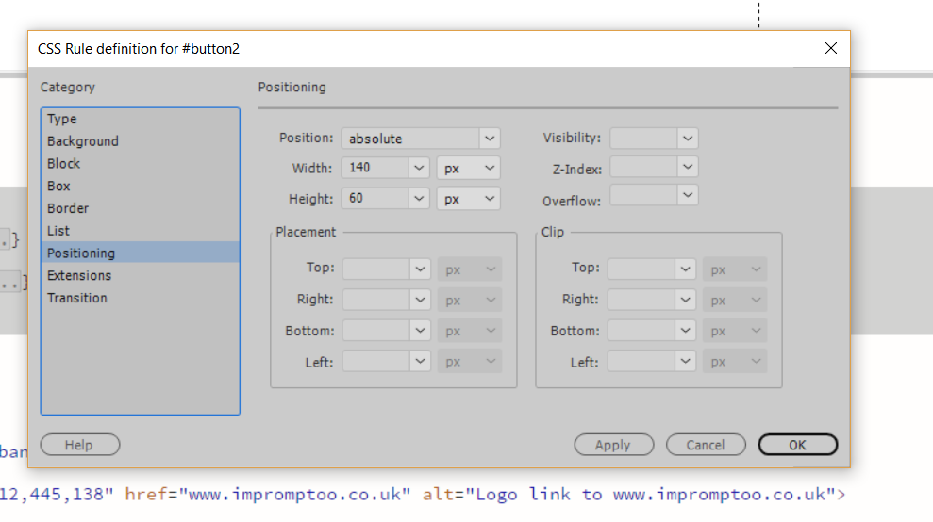

Slide 26
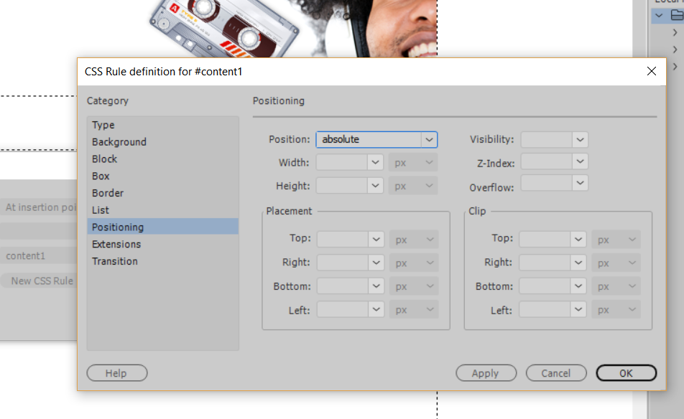
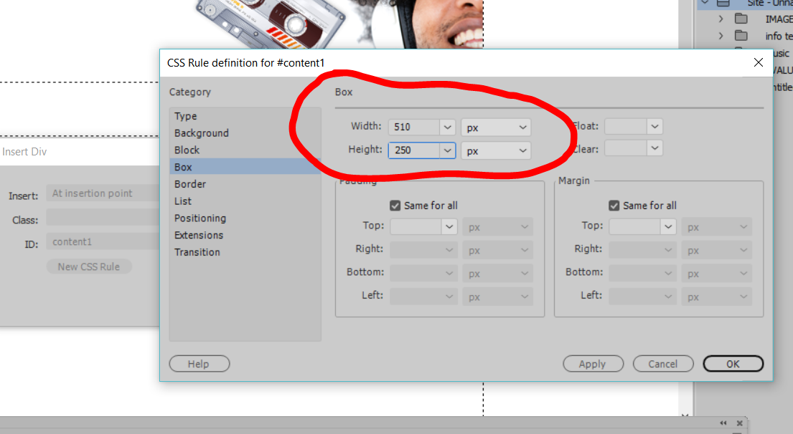

Slide 27
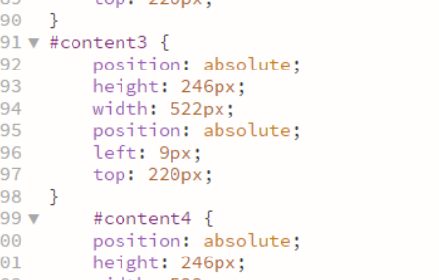

Slide 28
Footer

Slide 32
Add the footer text and format in footer div, then add link email.

Slide 33
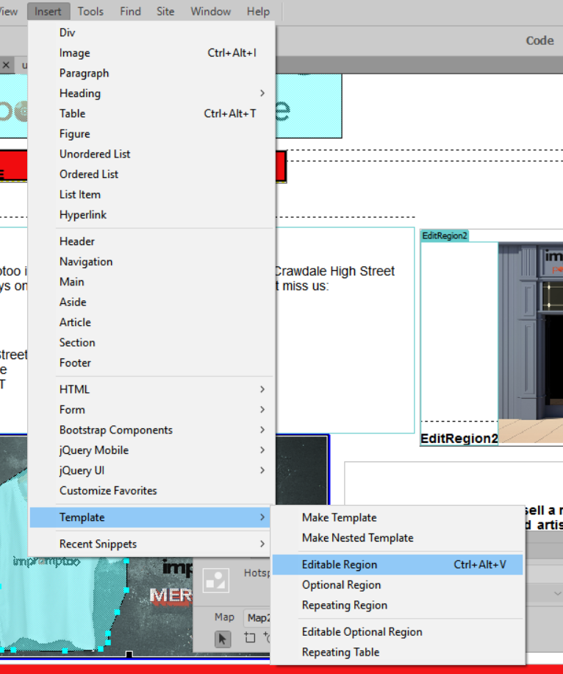

Slide 40
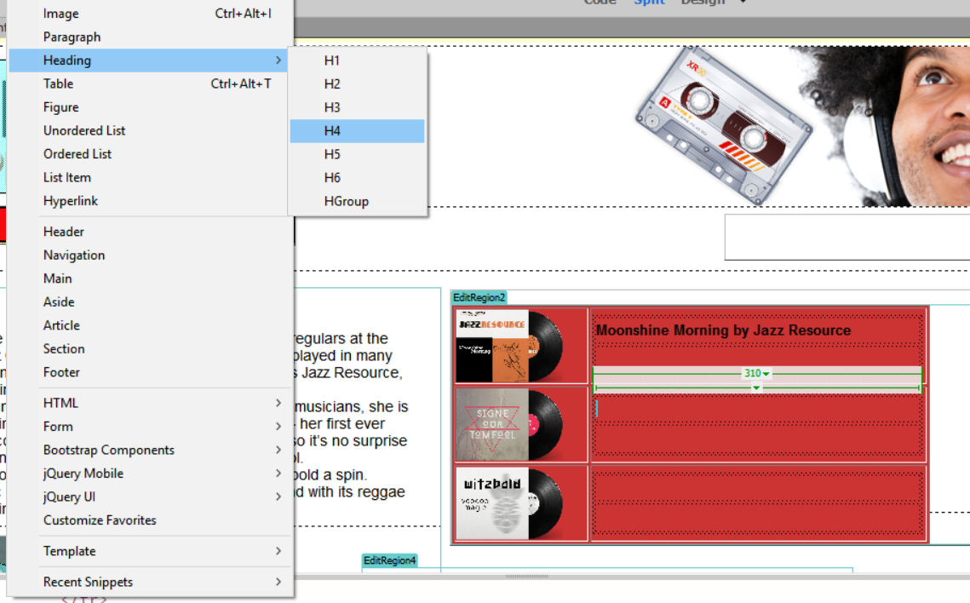

Slide 45
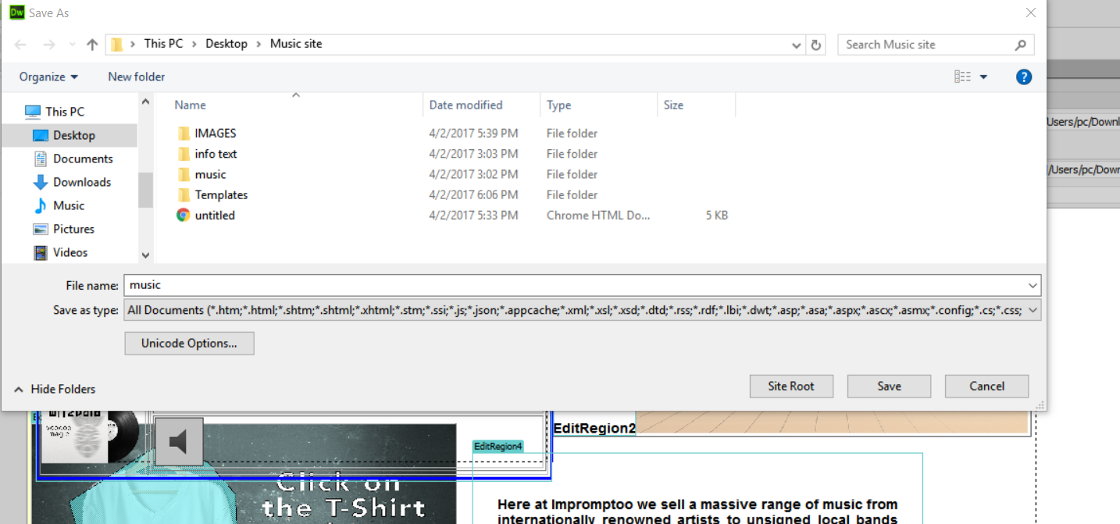

Slide 47
