Slide 1
Level 2 unit 1 Developing web products
Using Dreamweaver to make a site
Week 4
13/03/2017

Slide 2
Before you start – tools you need to know about in dreamweaver
https://helpx.adobe.com/dreamweaver/how-to/learn-user-interface.html
https://helpx.adobe.com/dreamweaver/how-to/use-property-inspector.html

Slide 3
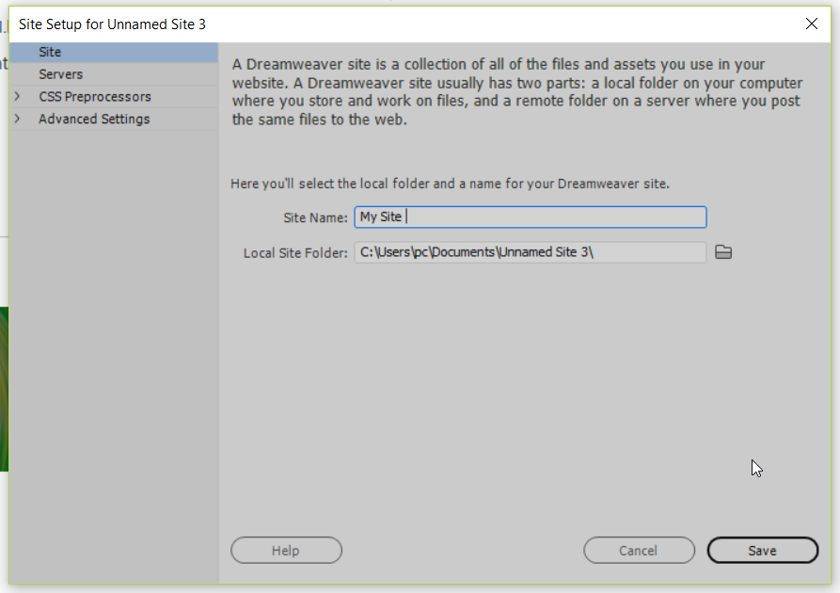
Before you create a page, you need to create a new folder for your site
1
2

Slide 4
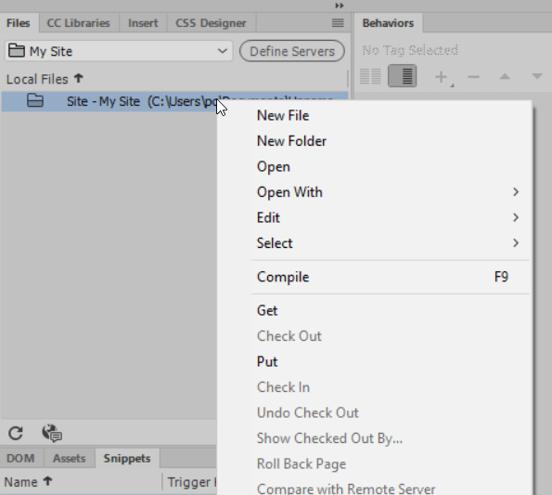
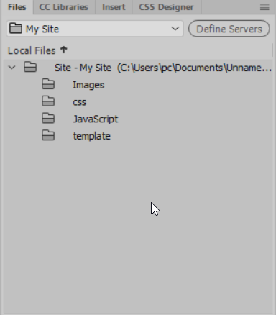
In your site root directory create 4 folders: Images css JavaScript template

Slide 5
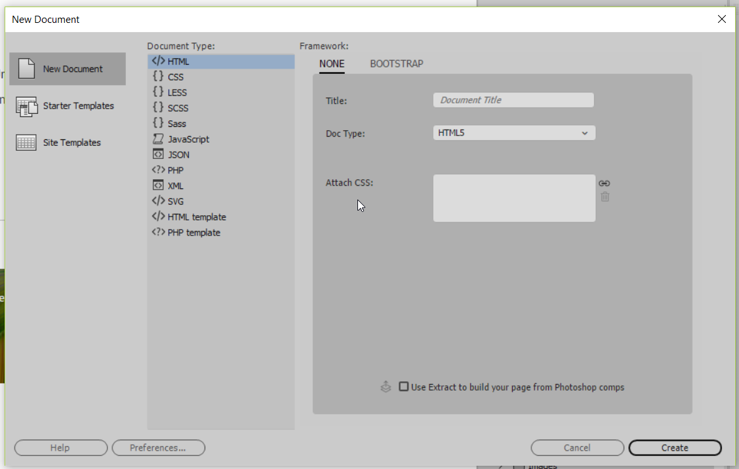
Create a new HTML document

Slide 6
You want to make sure you do a minimum typing so you need to have the properties panel and the insert panel in view. Go to window> properties window> insert

Slide 7
In the head before </head> add a title to your web page – site name
Add keywords to your site to google can find you
To add keywords just scroll down the insert panel unit you see the word keywords

Slide 8
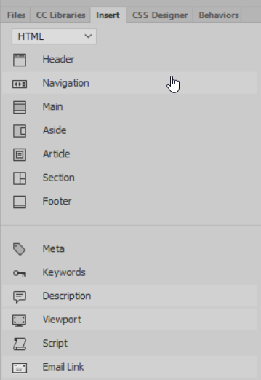
Add the description to your site using the same method than the keyword using the insert panel

Slide 9
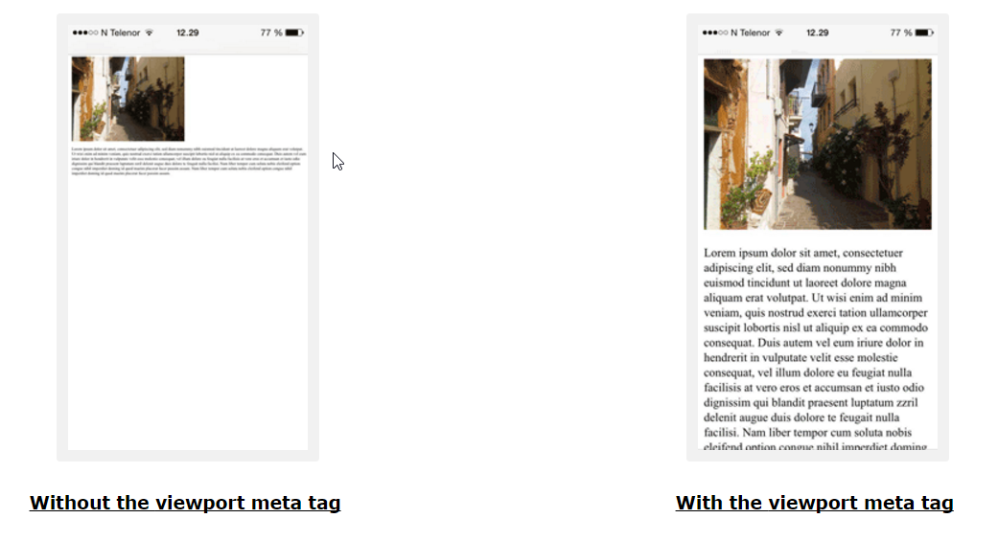
Add viewport using the same site panel
More information on viewport
https://www.w3schools.com/css/css_rwd_viewport.asp

Slide 10
For you unit 1 exam you will need to ensure that you don’t forget to add:
Viewport
Site title
Site keywords
Site Description

Slide 11
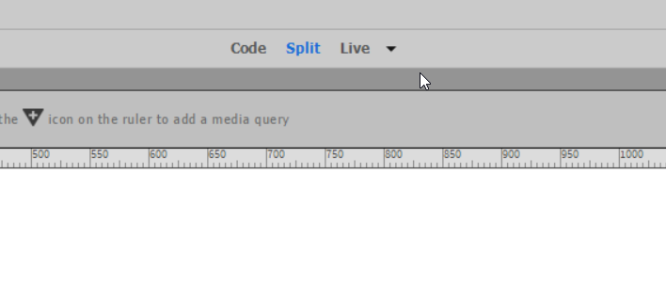
To make this site we will work in Split and live view

Slide 12
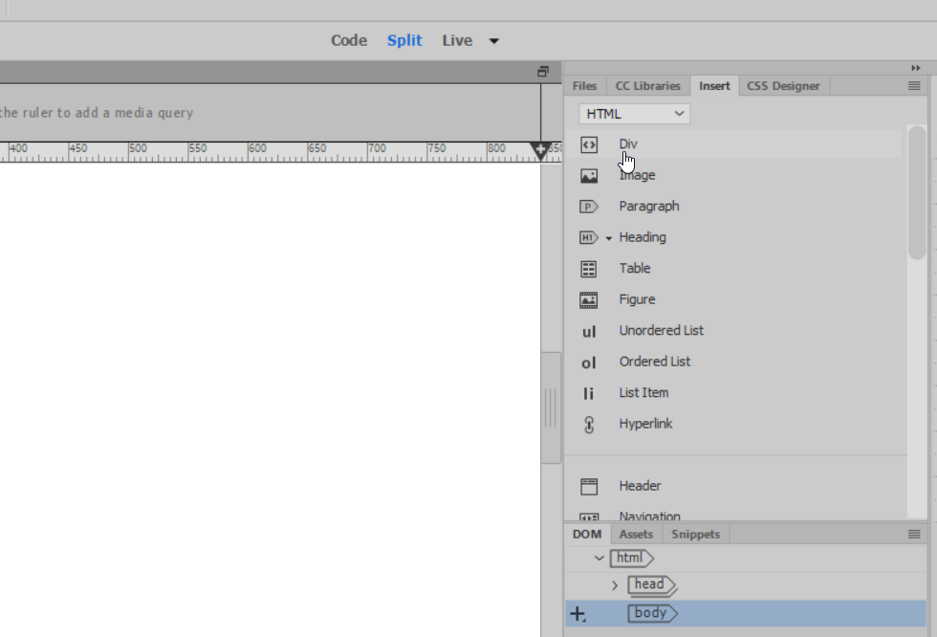
Using the insert panel add a div

Slide 13
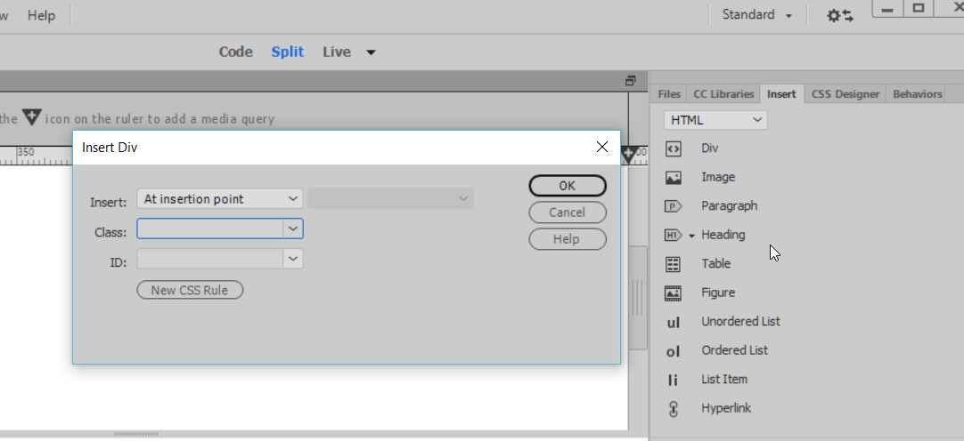
Making the site container is made using the div tag
A pop up window will ask you to set the div:
Class
Or ID
Or both
As we know that ID takes precedence over class I will give a class with the name wrapper to this div,

Slide 14
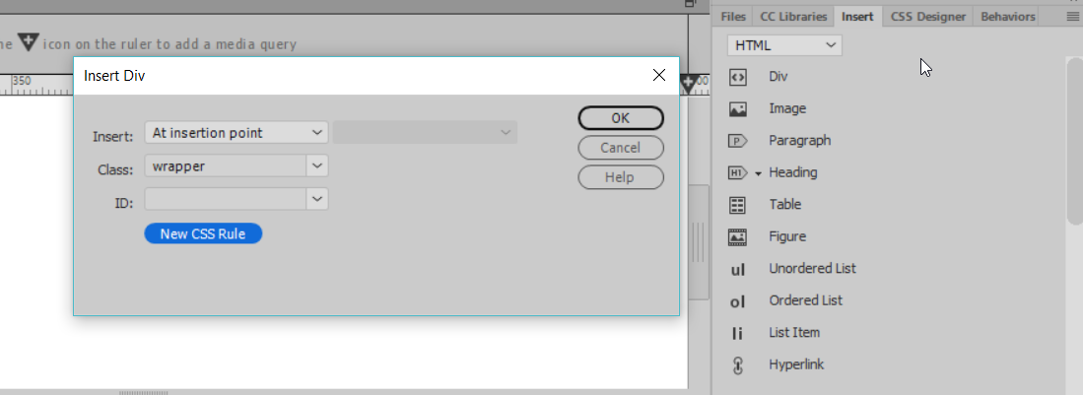
Click on New CSS rule to format the div.
For now you want to format with the page
You will then copy and paste the ccs in a new style sheet when you finish with your page

Slide 15
Click on new css rule to set the format of the div

Slide 16
Click ok. The info on the pop up window is just a reminder of what is a class, id, tag
If you want you can apply the style in a new style sheet.

Slide 17
Now you can set all your formatting to this div using the pop up window

Slide 18
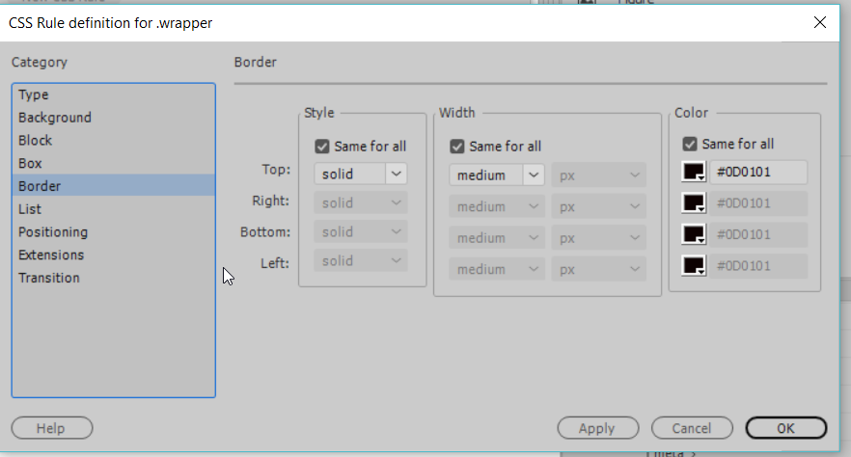

Slide 19
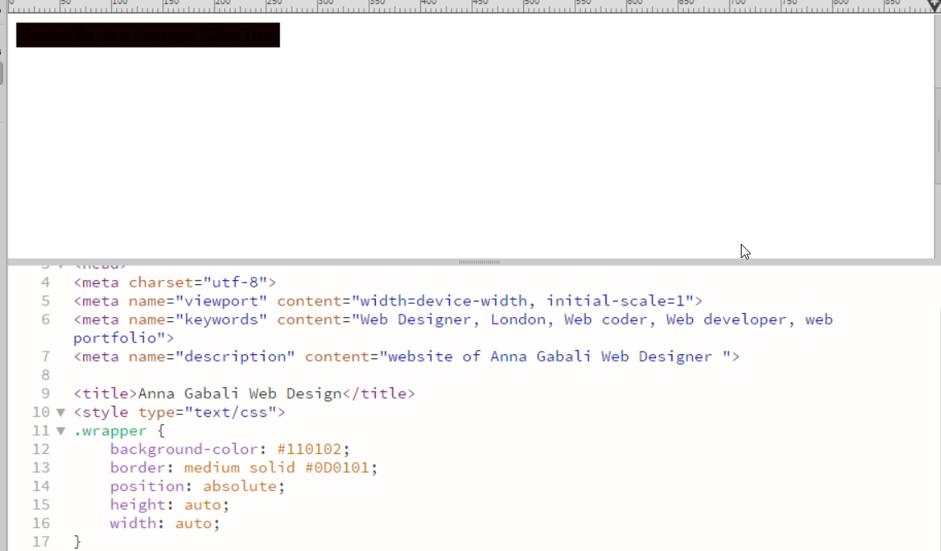
Not too much typing! And you have formatted a div

Slide 20
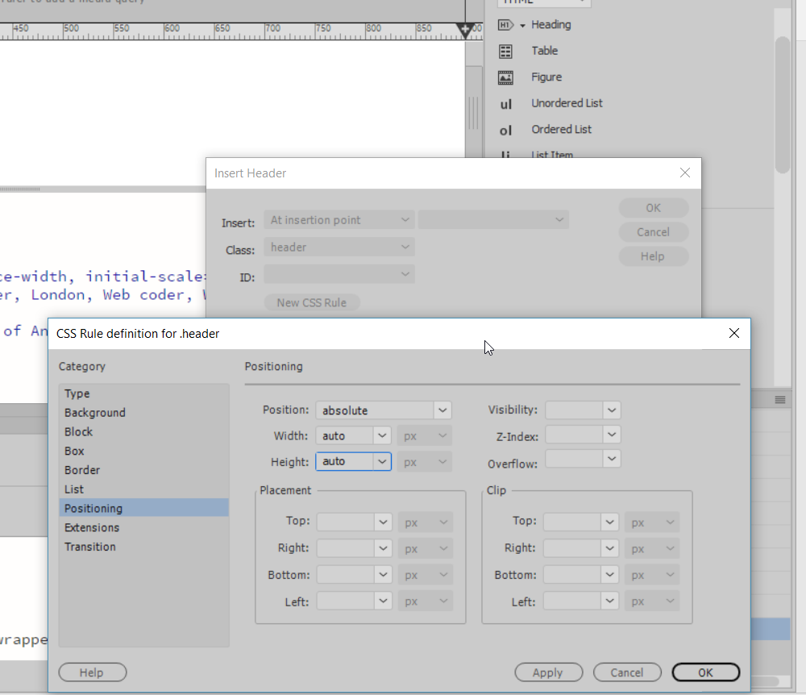
Now place your cursor between the div (class=“wrapper”) and add a header div using the site panel. Give it a class of header, Format it using the New CSS rules button.

Slide 21
If not happy with what you see, scroll to you code in code view and change what you want to change

Slide 22
Place your cursor just after </header> and add a navigation tag using the insert panel

Slide 23
Editing your css in the properties inspector. Make sure the Properties inspector is in view and click on css on the left of the panel an click edit rules

Slide 24
Adding a links

Slide 25
Add a Main Section and format it
The main tag is for the main content of a page meaning the if this page was a template this section would change on every page. This main tag cannot be place in aside, section ect…

